Slide 1
CEF 440: INTERNET PROGRAMMING (J2EE) AND MOBILE PROGRAMMING
IMPLEMENTATION OF DATABASE FOR
CarryAmGo MOBILE APPLICATION
Course Instructor
DR. VALERY NKEMENI
Here is where your presentation begins

Slide 2
What is CarryAmGO ?
CarryAmGo is a mobile application that facilitates and ensures a seamless interaction between buyers and sellers in a market setting ,enabling buyers to access information about availability, prices and locations , while empowering sellers to showcase their products and market locations

Slide 3
WHAT IS A DATABASE
IMPORTANCE OF A WELL DESIGNED DATABASE
A database is is a structured collection of data that is organised in a way that enables efficient storage , retrieval and manipulation of data
DATA INTEGRITY
SECURITY
SCALABILTY
COST
PEFORMANCE

Slide 4
Database functional Requirements
DATA STORAGE
DATA RETREIVAL
DATA ENTRY
DATA MANIPULATION
USER MANAGEMENT
INTEGRATION
PEFORMANCE

Slide 5
DATABASE NON-FUNCTIONAL REQUIREMENTS
PERFORMANCE
SCALABILITY
SECURITY
USABILITY
COMPATIBILITY

Slide 6
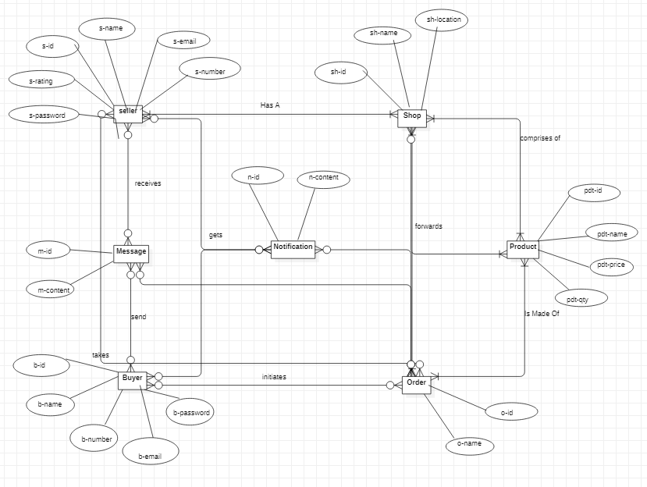
ENTITY RELATIONSHIP DIAGRAM

Slide 7
LOGICAL SCHEMA
Seller(s-id, s-name, s-email, s-number, s-password, s-rating)
Message(m-d, m-text)
Receives(*s-id, *m-id)
Buyer(b-id, b-name, b-number, b-email, b-password)
Send(*b-id, *m-id)
Order(o-id, o-name)
Initiates(*b-id, *o-id)
Takes(*s-id, *o-id)
Notification(n-id, n-content)
Shop(sh-id, sh-name, sh-location)
Has A(*s-id, *sh-id)
Products(pdt-id, pdt-name, pdt-price, pdt-qty)
Comprises Of(*sh-id, *pdt-id)
Is Made Of(*o-id, *pdt-id)
Gets(*b-id, *s-id, *n-id)
Forwards(*m-id, *n-id, *sh-id, *o-id, *pdt-id)

Slide 8
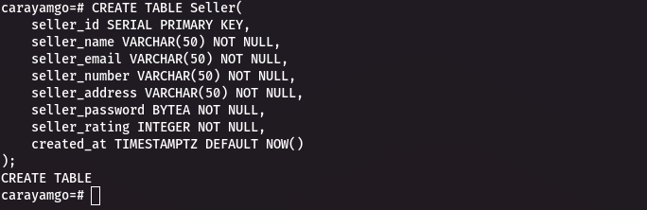
DATABASE IMPLEMENTATION
SELLER TABLE

Slide 9
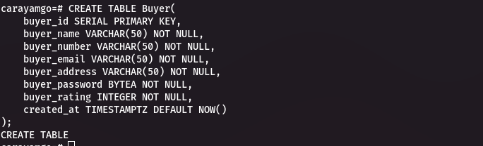
DATABASE IMPLEMENTATION
BUYER TABLE

Slide 10
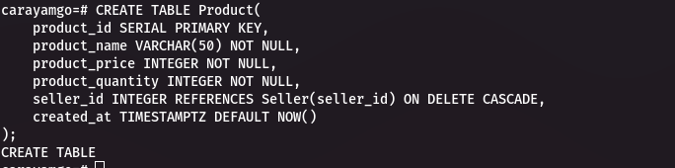
DATABASE IMPLEMENTATION
PRODUCT TABLE

Slide 11
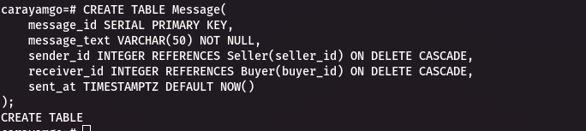
DATABASE IMPLEMENTATION
MESSAGETABLE

Slide 12
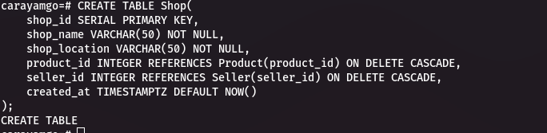
DATABASE IMPLEMENTATION
SHOP TABLE

Slide 13
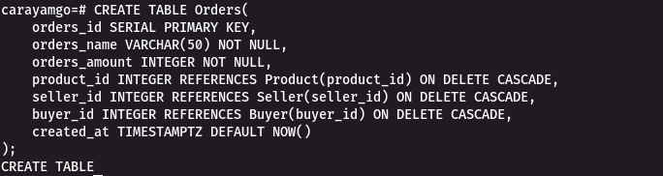
DATABASE IMPLEMENTATION
ORRDER TABLE

Slide 14

DATABASE IMPLEMENTATION
NOTIFICATIONS TABLE

Slide 15
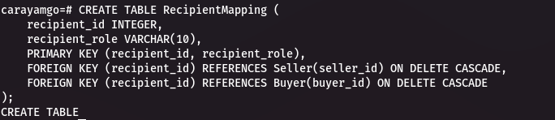
DATABASE IMPLEMENTATION
RECIPIENT MAPPING TABLE

Slide 16
DATABASE IMPLEMENTATION
ADMIN TABLE

Slide 17
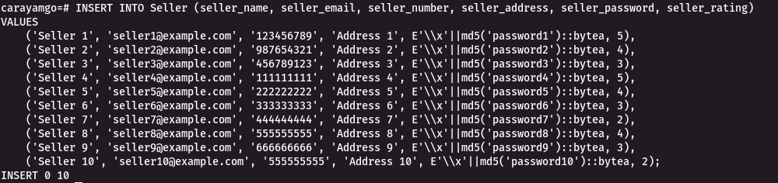
DATABASE IMPLEMENTATION
DATA INSERTION
INSERTING DATA INTO THE SELLER TABLE

Slide 18
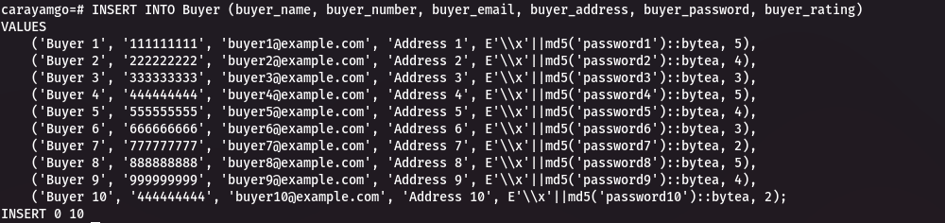
DATABASE IMPLEMENTATION
DATA INSERTION
INSERTING DATA INTO THE BUYER TABLE

Slide 19
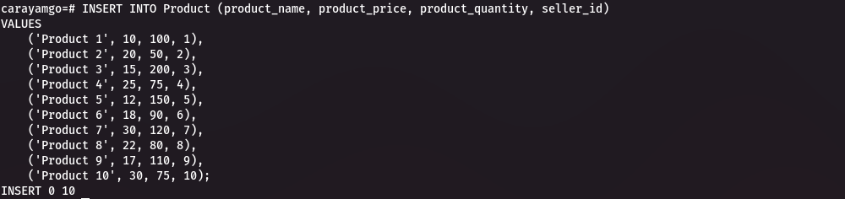
DATABASE IMPLEMENTATION
DATA INSERTION
INSERTING DATA INTO THE PRODUCT TABLE

Slide 20
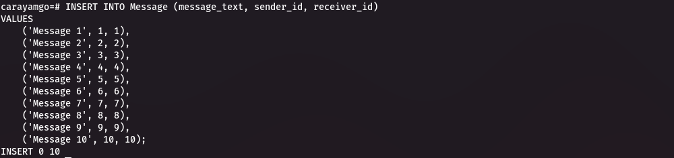
DATABASE IMPLEMENTATION
DATA INSERTION
INSERTING DATA INTO THE MESSAGE TABLE

Slide 21
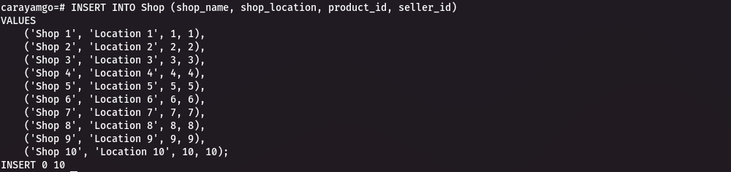
DATABASE IMPLEMENTATION
DATA INSERTION
INSERTING DATA INTO THE SHOP TABLE

Slide 22
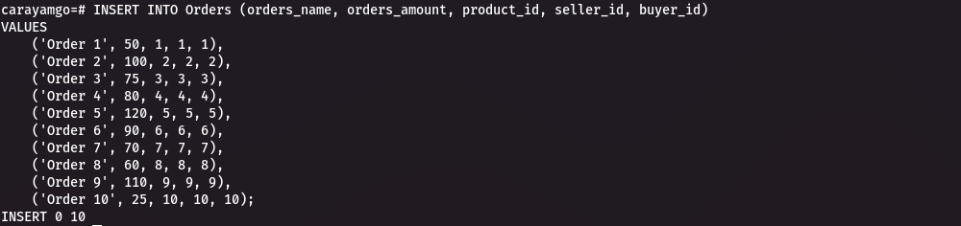
DATABASE IMPLEMENTATION
DATA INSERTION
INSERTING DATA INTO THE SHOP TABLE

Slide 23
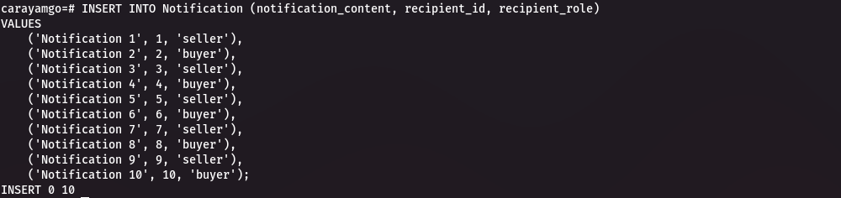
DATABASE IMPLEMENTATION
DATA INSERTION
INSERTING DATA INTO THE NOTIFIĆATION TABLE

Slide 24
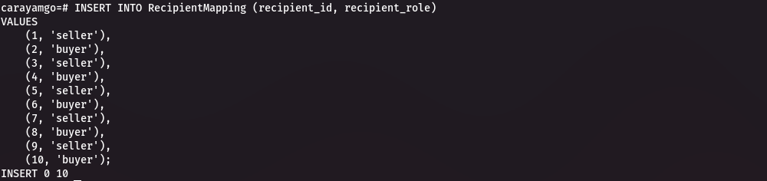
DATABASE IMPLEMENTATION
DATA INSERTION
INSERTING DATA INTO THE RECIPIENT MAPPING TABLE

Slide 25
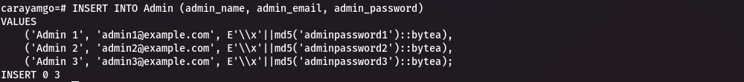
DATABASE IMPLEMENTATION
DATA INSERTION
INSERTING DATA INTO THE ADMIN TABLE

Slide 26
MEASURES OF DATA SECURITY AND INTEGRITY IN OUR DATABASE
SEXURE AUTHENTICATION
DATA MINIMIZATION

Slide 27
CONCLUSION
In conclusion, the security and integrity of user data in the Carryamgo mobile application are paramount.
SO YOUR DATA IS SAFE WITH CarryAmGO

Slide 28
THANK YOU

